Slide 1

Prooving the non-solvability of the friends’ problem
(from a certain number of friends)
Alessio Cappello, Lorenzo Nikiforos
alessio.cappello@studenti.polito.it, lorenzo.nikiforos@studenti.polito.it

Slide 2
Quick recap of the problem
N friends, after eating in a pizzeria, decide to move to a pub
Half of them study Computer Engineering (C), the other half Data Science (D)
They have only a tandem (two seats) to move
NEVER have less D than C in either side, otherwise the data scientists will get annoyed by the geeks (C) and will leave

Slide 3

Thesis
The problem, this formulated, cannot be solved from a certain number of friends: in our case, we will consider N≥14 (let’s call M the number of both C and D: we will have M≥7)
It doesn’t mean that for N<14 the problem is always solvable: we focused to proof that the problem is unsolvable for N≥14

Slide 4
Demonstration
Since the tandem can bring only two people, we cannot see an increase higher than 2 (i.e. it’s impossible to go from 2 to 5 data scientists at the pub)
At a certain point, we will have 3 or 4 D at the pub, so all the possible states are:
*C[m-α]D[m-3] – C[α]D[3]
C[m-α]D[m-3] – *C[α]D[3]
*C[m-α]D[m-4] – C[α]D[4]
C[m-α]D[m-4] – *C[α]D[4]

Slide 5
What should be the value of α? Ignoring the bike:
C[m-α]D[m-3] – C[α]D[3]
C[m-α]D[m-4] – C[α]D[4]
It should be 3 or 4 otherwise the constraints would be violated, so:
*C[m-3]D[m-3] – C[3]D[3]
C[m-3]D[m-3] – *C[3]D[3]
*C[m-4]D[m-4] – C[4]D[4]
C[m-4]D[m-4] – *C[4]D[4]

Slide 6
Let’s consider the first state:
*C[m-3]D[m-3] – C[3]D[3]
Possible choices:
Moving one or two C: constraint violated at the pub
Moving one or two D: constraint violated at the pizzeria
Moving one C and one D: the only valid option, ending in
C[m-4]D[m-4] – *C[4]D[4]

Slide 7
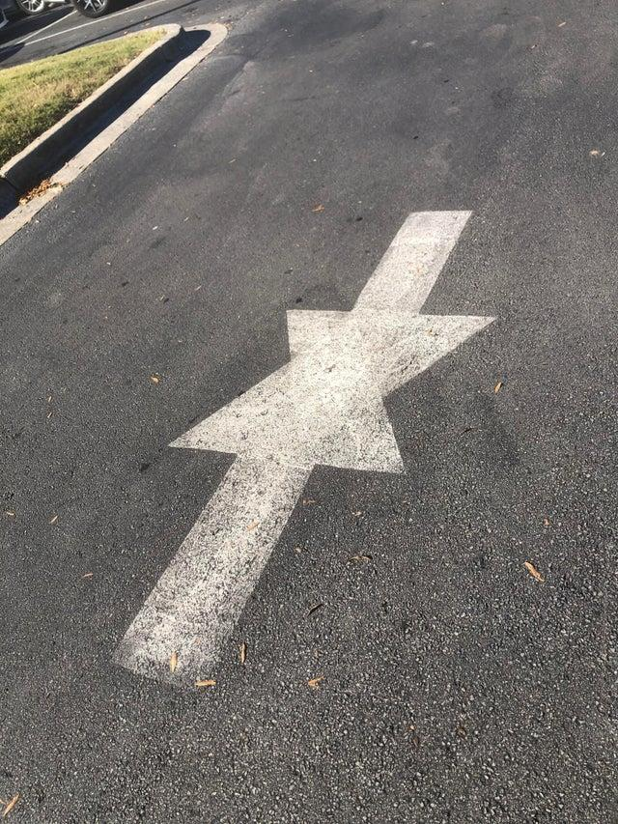
C[m-4]D[m-4] – *C[4]D[4]
And now? Again, possible choices:
Moving one or two C: constraint violated at the pizzeria
Moving one or two D: constraint violated at the pub
Moving one C and one D: again, the only valid option, ending in
*C[m-3]D[m-3] – C[3]D[3]
We are stuck! We can’t reach the goal
Similar reasoning can be conducted for the other states

Slide 8

To sum up
Due to the problem formulation, we are forced to go through one of the possible states we showed
Since none of them allow us to reach the goal, the problem is not solvable

